Slide 1
DR.SNSRCAS, CBE
SUBJECT: ADVANCED JAVA PROGRAMMING
COURSE CODE:16UCA502
TITLE: Servlet interface
YEAR: V SEMESTER 2022-2023 (ODD)

Slide 2
Servlet interface
Servlet interface provides common behaviorto all the servlets. Servlet interface defines methods that all servlets must implement.

Slide 3
Servlet interface
Servlet interface needs to be implemented for creating any servlet (either directly or indirectly). It provides 3 life cycle methods that are used to initialize the servlet, to service the requests, and to destroy the servlet and to non-life cycle methods.

Slide 4
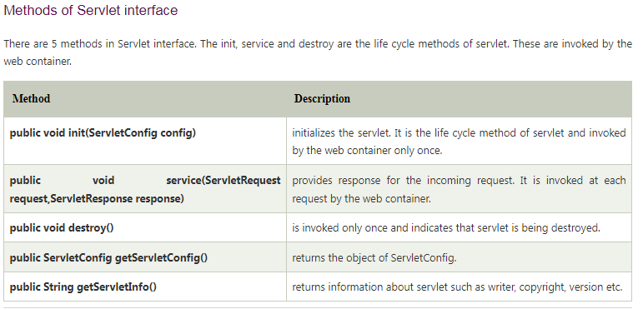
Servlet interface

Slide 5
Servlet interface
File: First.java
import java.io.*;
import javax.servlet.*;
public class First implements Servlet{
ServletConfig config=null;
public void init(ServletConfig config){
this.config=config;
System.out.println("servlet is initialized");
}
public void service(ServletRequest req,ServletResponse res)
throws IOException,ServletException{
res.setContentType("text/html");
PrintWriter out=res.getWriter();
out.print("<html><body>");
out.print("<b>hello simple servlet</b>");
out.print("</body></html>");

Slide 6
Servlet interface
}
public void destroy(){System.out.println("servlet is destroyed");}
public ServletConfig getServletConfig(){return config;}
public String getServletInfo(){return "copyright 2007-1010";}
}

Slide 7
THANK YOU

